Slide 1


SwiftCart Order Management System
Order-to-Delivery Business Flow & Technical Module Demonstration
Presented By: Md. Sadiya Tabassum
The ICFAI Foundation for Higher Education, IFHE, Hyderabad
Internship Assignment Submission
Biztab Consulting Services

Slide 2


Project Objective
Designing and demonstrating a simplified Order-to-Delivery workflow used in modern ecommerce platforms.
Automating the order lifecycle
Validating customer orders
Managing inventory availability
Simulating delivery tracking
Improving workflow efficiency
Enhancing customer experience

Slide 3

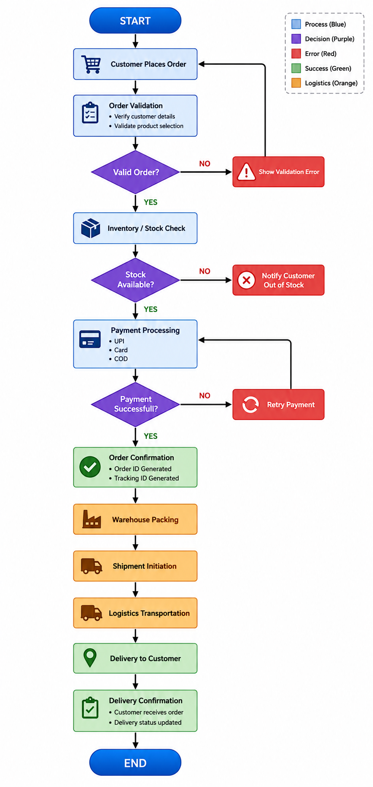

Order-to-Delivery
Business Flow
Workflow Highlights
The business flow illustrates the complete lifecycle of an ecommerce order processing system.
Order Placement & Validation
Real-time Inventory Checks
Multi-mode Payment Processing
Automated Order Confirmation
Integrated Shipment & Logistics
Final Delivery Confirmation

Slide 4


Selected Technical Module
Order Validation & Confirmation Module
Main Functionalities
Customer detail validation
Product selection validation
Inventory availability check
Payment method handling
Order & Tracking ID generation
Delivery estimation logic
Comprehensive error handling

Slide 5






Technologies Used
Core Frontend
HTML5, CSS3, JavaScript (ES6+)
UI/UX Features
HTML5
CSS3
JavaScript
VS Code
Glassmorphism Design, Animated Gradients, Responsive Layouts, Interactive Dashboards
Libraries & Tools: Font Awesome, Draw.io, Canva

Slide 6


System Features
Core Engine
Interface Design
Dynamic Order Confirmation
Fully Responsive Design
Real-time Tracking ID Generation
Modern Glassmorphism UI
Delivery Progress Simulation
Animated Interaction Components
Notification Popup Alerts
Live Dashboard Statistics
Smooth Loading Animations

Slide 7

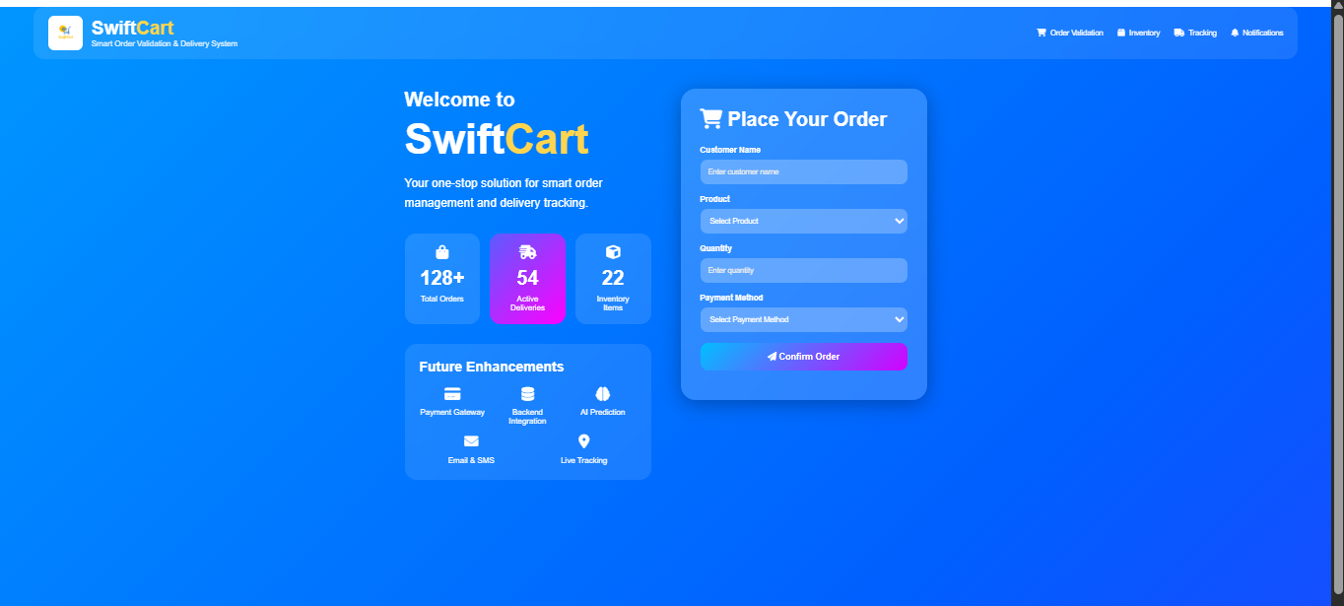
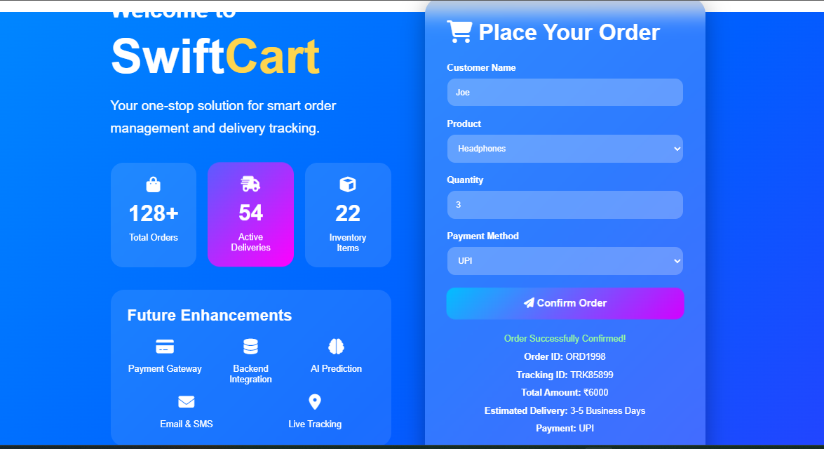
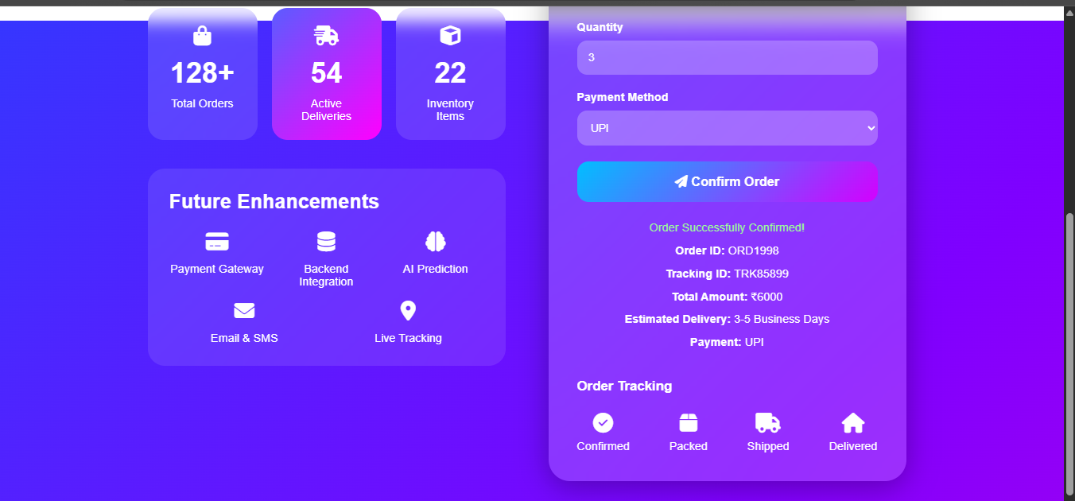
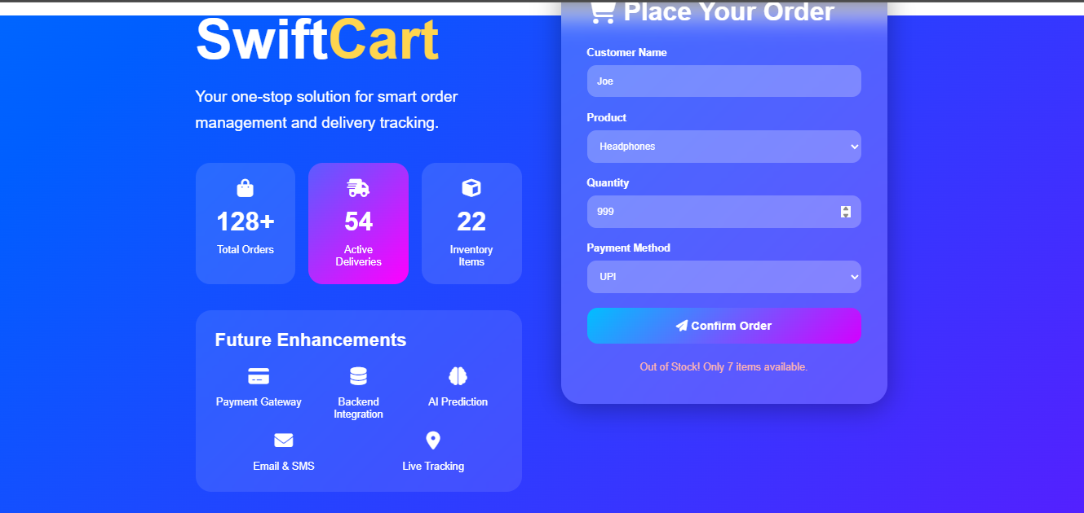
Project Demonstration

Slide 8


Future Enhancements
Real Payment Gateway Integration
Backend Database Connectivity (SQL/NoSQL)
AI-Based Demand Prediction
Customer Authentication System
Warehouse Management System
Comprehensive Admin Dashboard
Live Logistics & GPS Tracking
Cloud Deployment (AWS/Azure)
Automated Email & SMS Notifications

Slide 9


Challenges & Learnings
Key Learnings
Challenges Faced
Deep business workflow understanding
Designing a responsive UI for all screens
Advanced frontend development practices
Implementing interactive tracking animations
Modern UI/UX enhancement techniques
Managing complex inventory validation logic
Real-world ecommerce process modeling
Structuring a professional dashboard

Slide 10

Conclusion
The SwiftCart Order Management System successfully demonstrates a simplified Order-to-Delivery workflow through an interactive frontend implementation.
This solution reflects the core functionality used in modern ecommerce platforms.
Thank You
Questions & Discussion

